Slide 1

Legal Archiving & Records management, existing technologies and solutions
Marc Vandeveken - I.R.I.S.

Slide 2
Agenda
Definition
Key drivers and objectives
The actual picture…
Impact on IDR, ECM and ICT.
Q & A

Slide 3
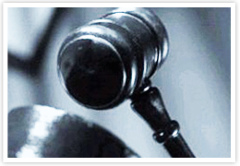
Definition
« Archiving is the process of collecting, classifying and preserving information for future reference ».
Legal archiving is archiving for legal and regulation purposes.

Slide 4

Key Drivers and Objectives
E-docs replace P-docs…
  80% of the information is located in e-mails, e-docs and web.
  Most of the key-business transactions are now processed electronically.
  Volume of p-docs is decreasing.
  Paper archive : expensive, no added-value.
…but what about the legal value of E-docs ?
  Legal value of p-docs is obvious (signature), not the case for e-docs.
The Key objective of Legal Archiving is to legitimate electronic information by conferring it the same legal value as paper information).

Slide 5
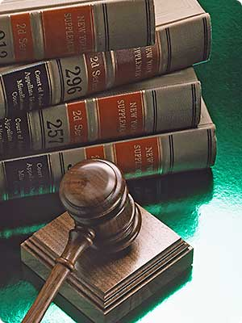
Key Drivers and Objectives
Legal and regulation pressure is growing …
  Increasing requirements for documents’ traceability, retention and disposition +
  Emerging requirements for private information protection implies :
    Proven destruction of private information after retention period expiration.
    Ability to prove the usage of private information (traceability).
Need to protect organization’s key information against :
  Unauthorized access, usage and alteration by internal users.
  Erroneous deletion or alteration by technical or business staff.

Slide 6
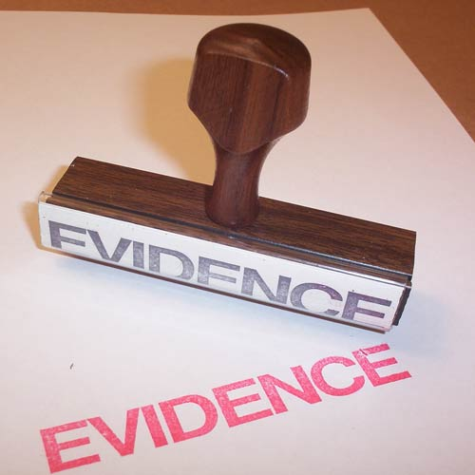
The actual picture
Original P-doc is considered as a proof.
E-doc can be considered as a proof when :
  “Its origin and author can be undoubtedly proved.”
    The document has been electronically signed (the author is known).
    A third-party certificate guaranties the undoubtable link between the signature and the content of the document. This certificate must be qualified (i.e : must rely on approved technologies, provider and must contain enough information).
  “No alteration has been made possible since the moment it has been created in its final form.”

Slide 7
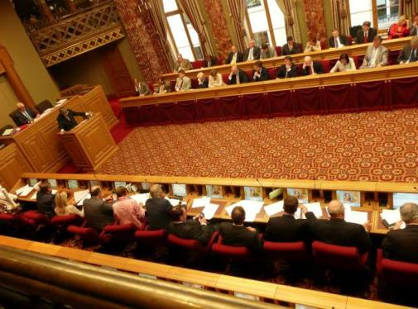
The actual picture…
To be used as a legal proof, an E-doc must be:
  authenticated
    (electronic signature + certificate)
  not altered (integrity)
    Secured and auditable process in the organization :
      End-to-end (from documentation creation/scanning to archiving)
      Traceability (who has done what ? When ?)
      “Contextual information” : Date, time, place of creation -> “time stamping” (Horodatage) would reinforce value of proof.
    Secured long-term storage

Slide 8
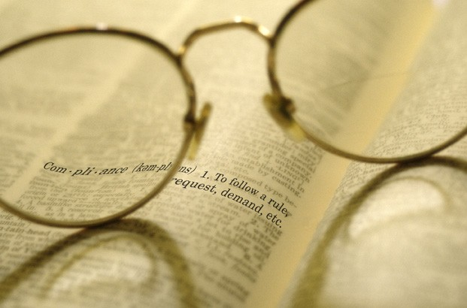
Concepts and criteria
No real legal text to define what “a reliable legal archiving system” must be.
Different norms exist :
  AFER – 16/2008 (E.T.112.081) dd. 13.05.2008:
    Condition and terms for storing and archiving the e-invoices and e-data based on the VAT law
    Legal context on the production and the archiving of e-docs
  NF – Z 42-013 (AFNOR France 2001 – new version in 2008) :
    Set of technical and operational measures to ensure a proper long-term storage and retrieval of electronic documents (scanned or produced by an IT application).
    Recommends optical storage - physical WORM-, new version also admits logical WORM.
  ISO 15 489 + MoReq :
    Dedicated to the records management.
    MoReq is the operational approach of ISO 15 489
  MoReq 2 :
    European Directive
    New version of MoReQ

Slide 9
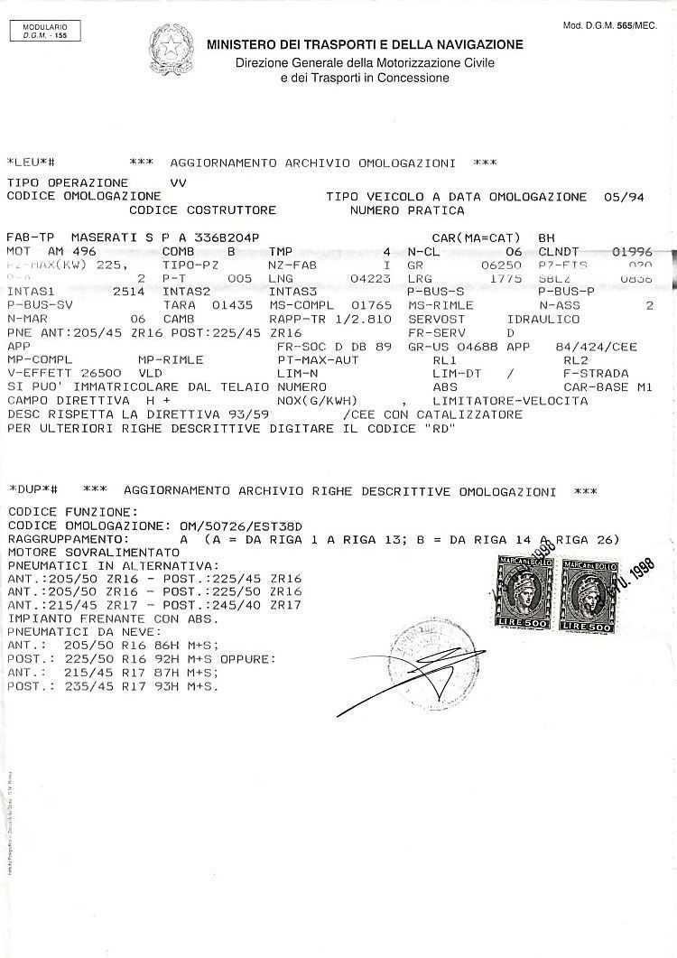
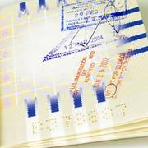
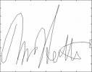
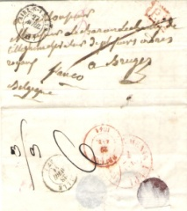
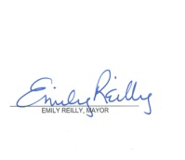


Concepts and criteria
Authenticity :
  Signature
  Time stamping
  Non alterability :
    Through the use of non-rewritable storage
      Physical WORM (optical juke-boxes)
      Logical WORM magnetic disk bays (IBM DR550, EMC Centera)
    Based only on the signature
      Normal magnetic disk (reinscriptible)
      Authentication through PKI
Durability:
  Technological cycle : < 10 years (minus the retention rules)
  Storage durability : 5-10 years (magnetic), 10-50 years (optical)
  Plan periodical upgrade of the systems
  Regularly verify storage media / perform duplicates through a validated procedure (use of masters).
  For magnetic disks, use RAID + hot-swappable disks.
  Use standard file formats (PDF/A-1A)

Slide 10
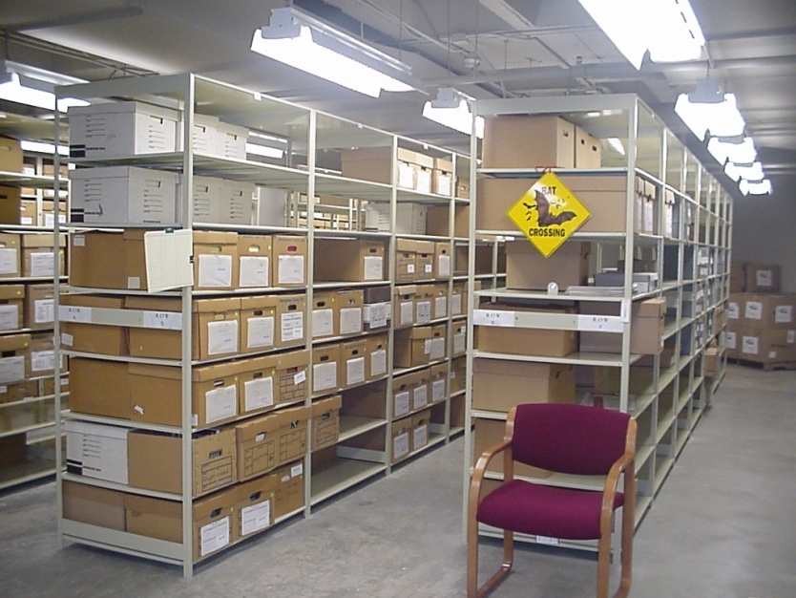
Concepts and criteria
Retention period
  Based on document type.
  When does it start :
    On creation date…
    After the last event date (example : account closing, death etc…)
  The retention delay can be freezed :
    Example : an account has been reopened.
    Legal archiving is a process, not a product

Slide 11
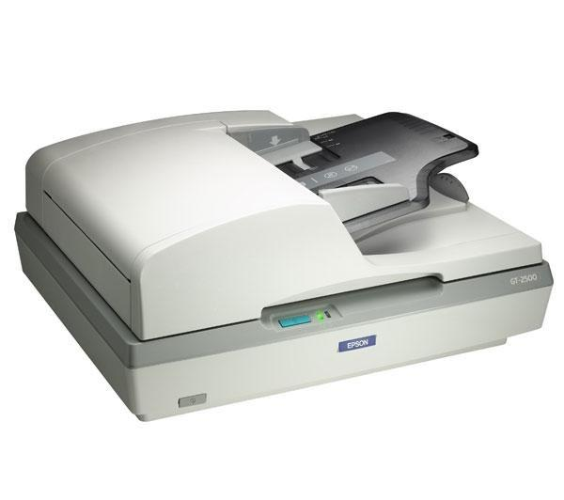

Impact on IDR, ECM and ICT
Impact on IDR (Legal Scanning – AFER regulation) :
  Endorsing (small print on scanned document : timestamp + operator ID).
  Identification of the scanning operator + scanner ID + date/time)
  Electronic signature + certificate during scanning process (pay attention to certificate management as they expire).
  Scanning application must be secured :
    No graphical editor authorizing the alteration of the image file.
    Use of non-alterable image format (TIFF group 4).
    Authentication of operator through sign-on.
    Use of dedicated network for scanning process.
  Image file associated with all meta-data released to ECM.
    The release process generates log files.
    Log files must be stored and controlled on a regular basis.
Legal Scanning

Slide 12

Impact on IDR, ECM and ICT
Impact on ECM
  No alteration of the original document is allowed…only annotation on a separate layer. No image editor is available → not technically possible to alter original document.
  Every operation on the original document is logged (search, read, annotate etc…).
  Should a modification of the original document is authorized, this is done through the use of versioning and strictly logged.
  Documents are encrypted and stored in specific legal hardware.
  Documents are stored according to retention rules (date-based or event-based).

Slide 13
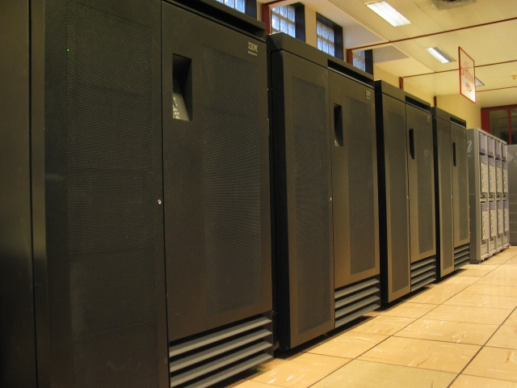
Impact on IDR, ECM and ICT
Impact on ICT (Storage)
  Use of specific legal storage hardware (ex : IBM DR550; EMC Centera).
    No “illegal” operations allowed (removal impossible).
    Management of retention period expiration (flag for destruction).
    Access data only from ECM solution (no file-system-like browsing).
    Possibility of logical data segregation
    Data security tools (mirroring, replication etc…)

Slide 14


How to face your major challenge:
Do more with less, while reducing your carbon footprint
Do more with less
  Automate processes
  Reduce workload
Legal Archiving is GREEN!
  Reduce paper volume
    Decrease square meters for archiving
    Printing no longer an obligation

Slide 15
Questions?

Slide 16

Thank you !!

